Slide 1

Pathlength-selective, interferometric Speckle Contrast Optical Spectroscopy
Non-Invasive Methods for Brain Research
Pathlength-Selective Interferometric Speckle Contrast Optical Spectroscopy
Shira Tziony
Supervisors: Dr. Nisan Ozana and Ms. Marina Vasileva
July 28, 2026

Slide 2
Table of content
Brain Imaging: Motivation and Limitations
Uses for Brain Imaging
Advantages and Limitations
Chosen method- Speckle Contrast Optical Spectroscopy
Rational
Main principles
Introducing Time and Coherence Gating
Temporal Point Spread Function and Instrument Response Function
Experiments
Setup
Noises and Limitations
Metrics
Pipeline and GUI
Results
TPSF and IRF measurements
Signal-to-Noise Ratio
Beats Per Minute
Sensitivity
Discussions and Conclusions
TPSF and IRF Performance
SNR and BPM Performance
Sensitivity Metric Limitations
Conclusions and Future Work
Signal Quality

Slide 3
Brain Imaging –Uses in the Medical Fiels
Stroke diagnosis and cerebral blood flow assessment
Brain tumor detection and surgical planning
Traumatic brain injury (TBI) monitoring
Epilepsy diagnosis and seizure localization
Neurodegenerative disease assessment (e.g., Alzheimer's, Parkinson’s)
Neurocritical care monitoring (ICP, oxygenation, brain function)
Functional brain mapping (motor, language, cognition)
Psychiatric and cognitive disorder research Rehabilitation
Brain-computer interfaces (BCIs)

Slide 4
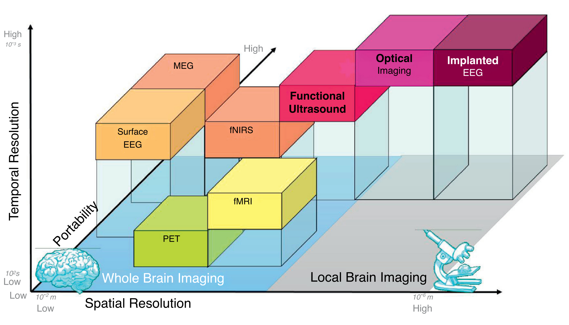
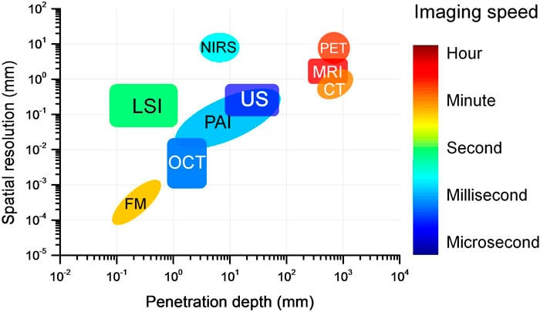
Brain Imaging – Non-Invasive Methods Available
For Speckle Contrast Optical Spectroscopy (SCOS):
  Special resolution of a few mm to a few cm
  High temporal resolution, but 50ms is sufficient (20 FPS)
Source: Thompson Rivers University (n.d.)
Source: Zhu, He & Chen (2018)

Slide 5
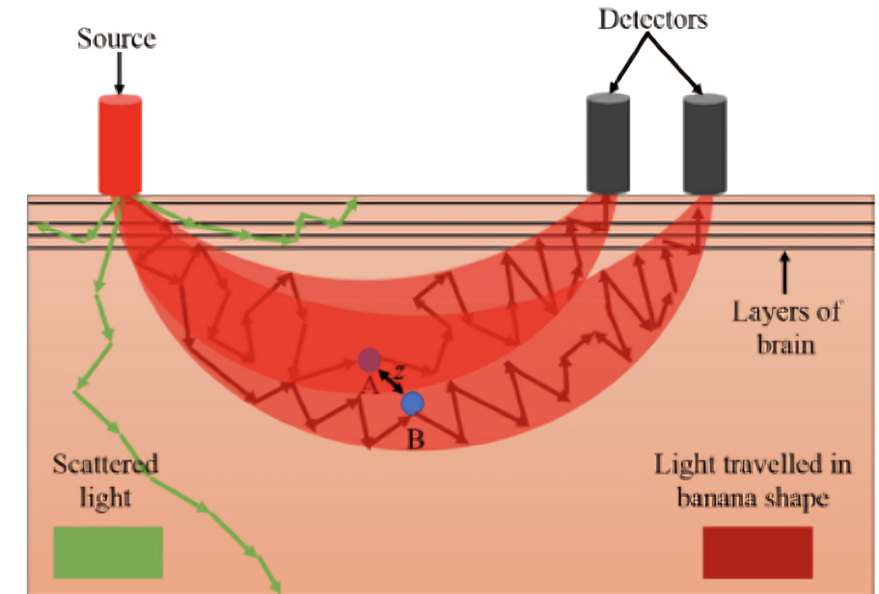
The Challenges of traditional SCOS
Sensetivity Limitation: dominated by superficial layers (scalp and skull)
Signal limitation: Increasing source detector separation (SDS) reduces signal quality
The Goal: Enhance depth sensitivity and signal quality by using time and coherence gating
Source: Stanford CIBSR (n.d.)

Slide 6
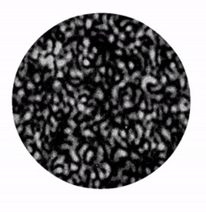
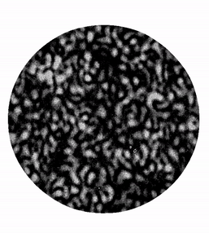


Relation Between Contrast to Movement -Rational
$$K=\frac{σ}{<I>}$$
Contrast
Speckle: scattered light randomly self interferes
Disturbance: changes the speckle formation
Integration: speckle movement causes blur
Low contrast -> High movement!
Camera Exposure
Signal
Excitation Trigger

Slide 7
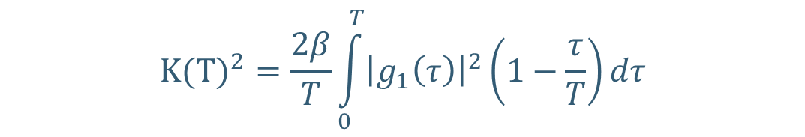
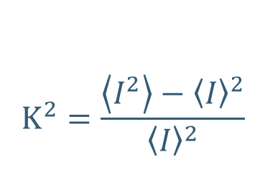

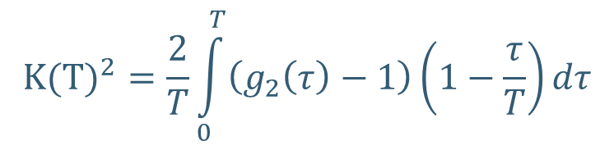

SCOS– Main Principles
Contrast squared
$$K^{2}=\frac{\left\langle I^{2}\right\rangle −{\left\langle I\right\rangle }^{2}}{{\left\langle I\right\rangle }^{2}}$$
Std of an intensity window
Exposure Time Limitations
$${K(T)}^{2}=\frac{2}{T}\int_{0}^{T}{\left(g_{2}\left(τ\right)−1\right)\left(1−\frac{τ}{T}\right)dτ}$$
$$=g_{2}\left(τ=0\right)−1$$
Average of an intensity window
Intensity autocorrelation function
$${K(T)}^{2}=\frac{2β}{T}\int_{0}^{T}{{\left|g_{1}\left(τ\right)\right|}^{2}\left(1−\frac{τ}{T}\right)dτ}$$
Siegert Relations
$$g_{2}\left(τ\right)=1+β{\left|g_{1}\left(τ\right)\right|}^{2}$$
Coherence Factor
Field autocorrelation function

Slide 8
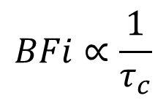
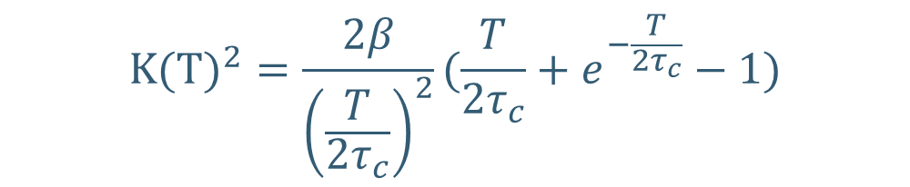



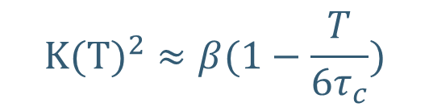
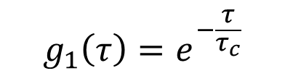
SCOS– Main Principles
$$g_{1}\left(τ\right)=e^{−\frac{τ}{τ_{c}}}$$
For our medium:
We can put into the last equation and get:
Blood Flow index:
Speckle decorrelation time
$$BFi∝\frac{1}{τ_{c}}$$
$${K(T)}^{2}=\frac{2β}{{\left(\frac{T}{2τ_{c}}\right)}^{2}}(\frac{T}{2τ_{c}}+e^{−\frac{T}{2τ_{c}}}−1)$$
$$T≪τ_{c}$$
$$T≫τ_{c}$$
$${K(T)}^{2}≈β(1−\frac{T}{6τ_{c}})$$
$${K(T)}^{2}≈β\frac{4τ_{c}}{T}$$

Slide 9
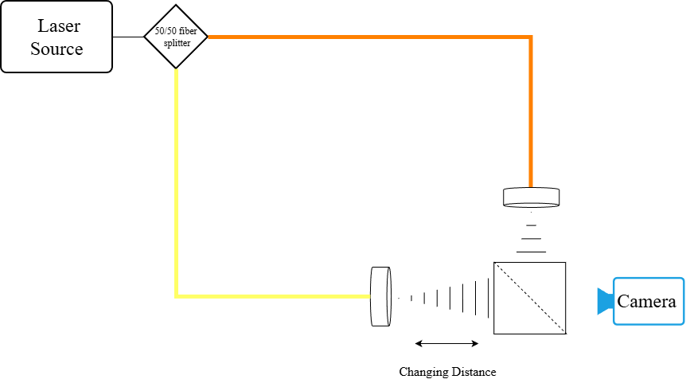
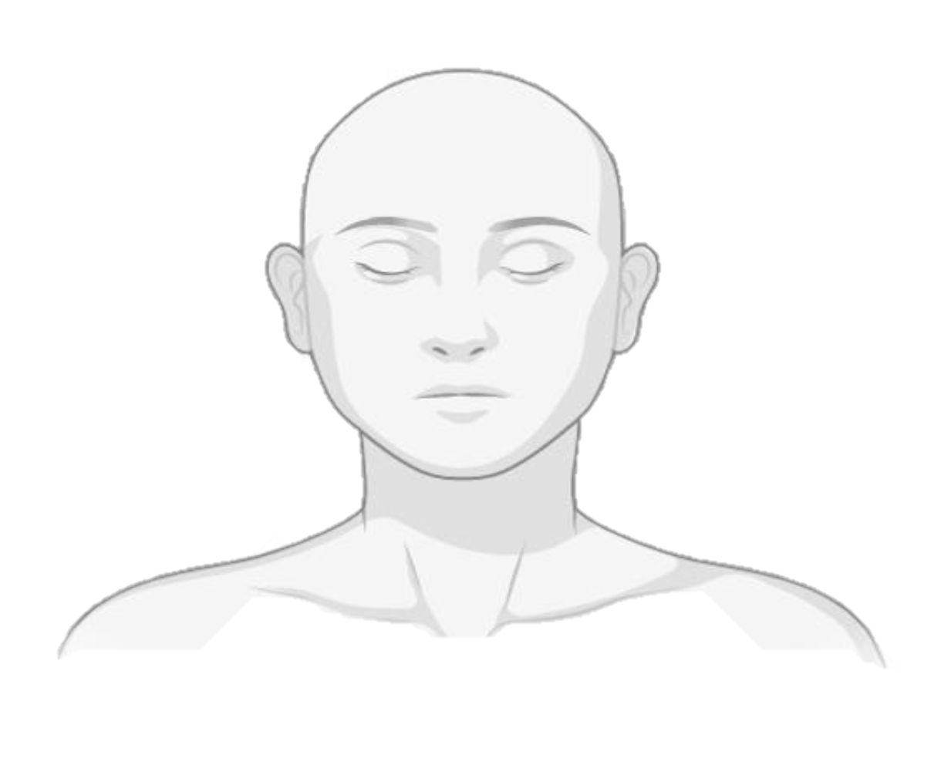
Pathlength Selective Interferometric SCOS (PaLS-iSCOS)– Introducing Time and Coherence Gating
A coherent Gaussian pulse is split
Sample widens the photon arrival time
Delayed reference amplifies late-arriving photons
A gated sensor can help filter early arriving photons
Sample
Reference
Changing distance
Instrument Response Function (IRF)
Temporal Point Spread Function (TPSF)

Slide 10
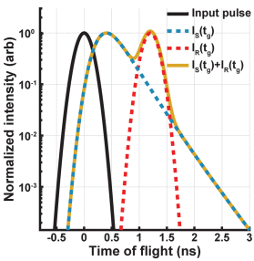

TPSF vs Reference IRF
IRF
TPSF
Defined by the laser pulse
Defines the coherence gate length:
Defines the arrival of photons from the tissue
Later arriving photons will be at the tail
Velocity in tissue
FWHM of laser pulse
$$l_{C}=\frac{υ FWHM}{\sqrt{log⁡(2)}}$$
Timing of the reference is crucial!
Source: Robinson et al. (2025)

Slide 11
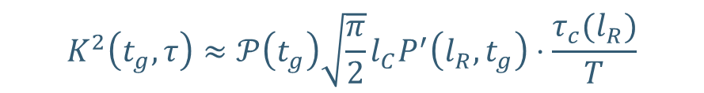
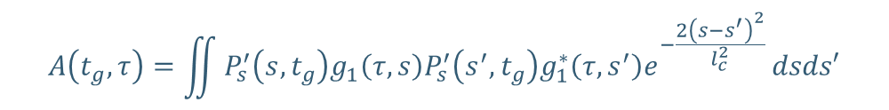
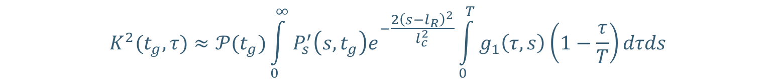
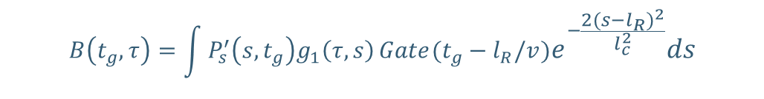

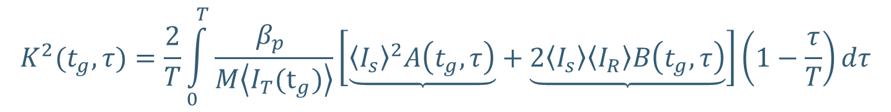

Revised theory for Time and Coherence Gating
$$K^{2}(t_{g},τ)=\frac{2}{T}\int_{0}^{T}{\frac{β_{p} }{M\left\langle I_{T}(t_{g})\right\rangle }\left[\underbrace{{\left\langle I_{s}\right\rangle }^{2}A\left(t_{g},τ\right)}+\underbrace{2\left\langle I_{s}\right\rangle \left\langle I_{R}\right\rangle B\left(t_{g},τ\right)}\right]\left(1−\frac{τ}{T}\right)dτ}$$
Pathlength difference
SCOS term
Interferometric term
Time gate
Total Intensity
$$A\left(t_{g},τ\right)=\iint{P_{s}^{′}\left(s,t_{g}\right)g_{1}\left(τ,s\right)P_{s}^{′}\left(s^{′},t_{g}\right)g_{1}^{∗}\left(τ,s^{′}\right)e^{−\frac{2{\left(s−s^{′}\right)}^{2}}{l_{c}^{2}}}}dsds′$$
$$B\left(t_{g},τ\right)=\int{P_{s}^{′}\left(s,t_{g}\right)g_{1}\left(τ,s\right)}Gate(t_{g}−l_{R}/v)e^{−\frac{2{\left(s−l_{R}\right)}^{2}}{l_{c}^{2}}}ds$$
Effective path length distribution
$$\left\langle I_{R}\right\rangle ≫\left\langle I_{s}\right\rangle$$
Gate Profile
Coherence length
$$K^{2}(t_{g},τ)≈𝒫(t_{g})\int_{0}^{∞}{P_{s}^{′}\left(s,t_{g}\right)e^{−\frac{2{\left(s−l_{R}\right)}^{2}}{l_{c}^{2}}}}\int_{0}^{T}{g_{1}\left(τ,s\right)\left(1−\frac{τ}{T}\right)}dτds$$
$$l_{C}→0 , T≫τ_{c}$$
$$K^{2}\left(t_{g},τ\right)≈𝒫\left(t_{g}\right)\sqrt{\frac{π}{2}}l_{C}P^{′}\left(l_{R},t_{g}\right)⋅\frac{τ_{c}(l_{R})}{T}$$
11

Slide 12
Experiment Setup and Design
Setup
Noises and Limitations
Metrics
Pipeline and GUI

Slide 13
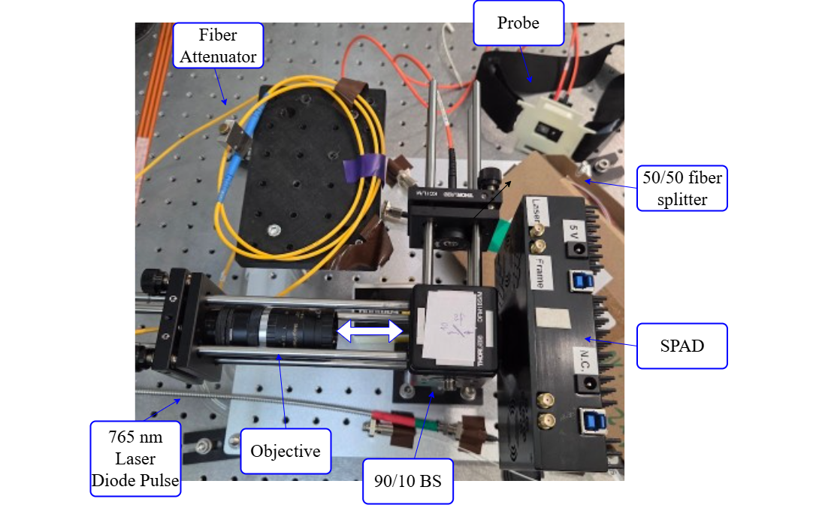
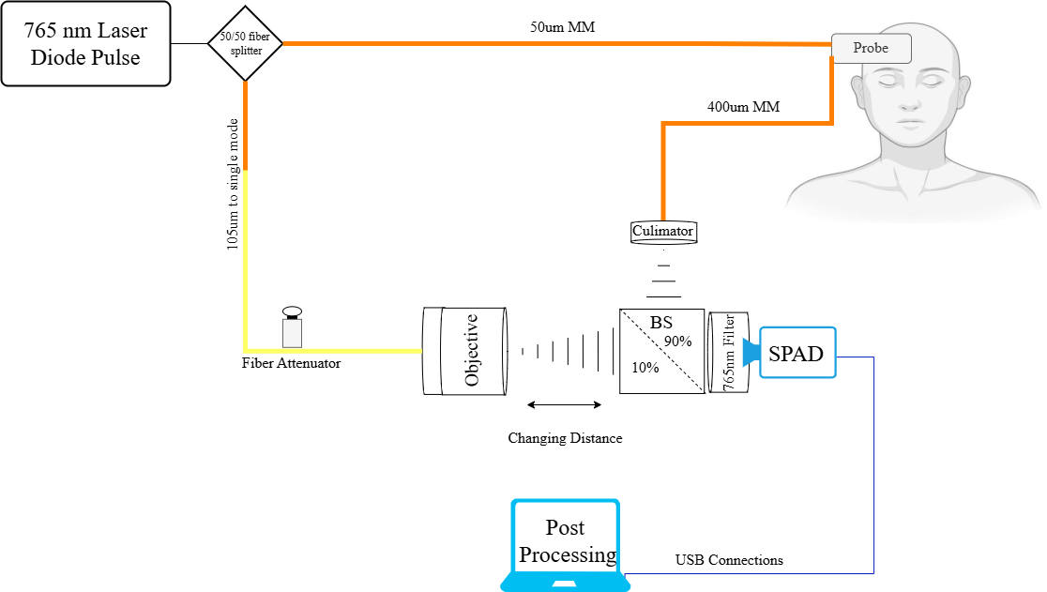
PaLS-iSCOS vs Gated SCOS
Experiment Setup
Laser Power
% | mW
30 | 3
35 | 6
40 | 12
45 | 15
55 | 27
Camera: SPAD512 from PI-Imaging
SPAD = single-photon avalanche diode
Laser Source: 765nm laser pulse (FWHM ~350ps, 20MHz)
Probes: 1cm, 1.5cm,2.5cm source-detector separation (SDS)

Slide 14
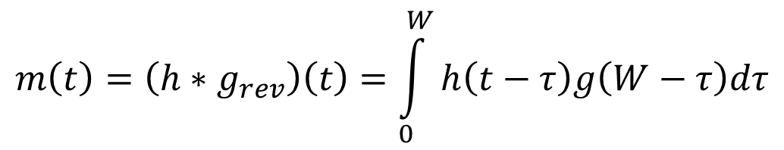
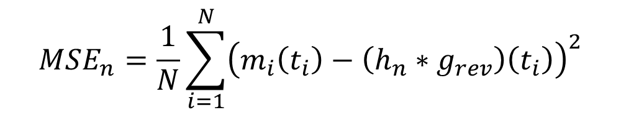
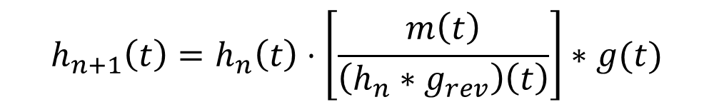
TPSF Measurement With Long Gate
$$m\left(t\right)=\left(h∗g_{rev}\right)\left(t\right)=\int_{0}^{W}{h\left(t−τ\right)g\left(W−τ\right)dτ}$$
Image captured by SPAD
True TPSF/IRF
SPAD gate (smearing effect)
Challenge: camera gate (6ns) is wider than IRF/TPSF FWHM (350ps to 700ps)
Solution: Richardson-Lucy Algorithm, an iterative solution to compute the TPSF
Stopping point: minimum MSE
$$h_{n+1}\left(t\right)=h_{n}\left(t\right)⋅\left[\frac{m\left(t\right)}{\left(h_{n}∗g_{rev}\right)\left(t\right)}\right]∗g(t)$$
$$MSE_{n}=\frac{1}{N}\sum_{i=1}^{N}{{\left(m_{i}\left(t_{i}\right)−\left(h_{n}∗g_{rev}\right)\left(t_{i}\right)\right)}^{2}}$$

Slide 15
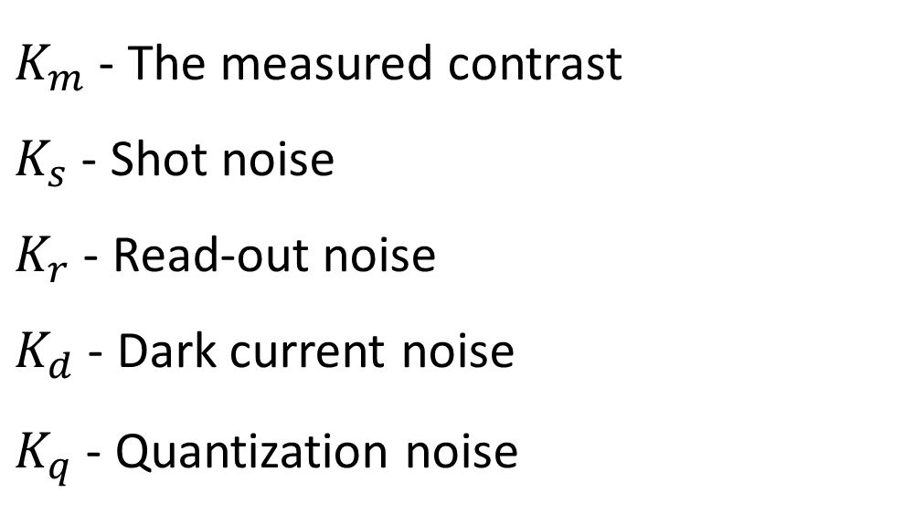
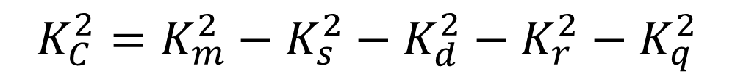
SCOS Noise Model
$$K_{C}^{2}=K_{m}^{2}−K_{s}^{2}−K_{d}^{2}−K_{r}^{2}−K_{q}^{2}$$
$K_{m}$ - The measured contrast
$K_{s}$ - Shot noise
$K_{r}$ - Read-out noise
$K_{d}$ - Dark current noise
$K_{q}$ - Quantization noise
Doesn’t exist in SPAD

Slide 16

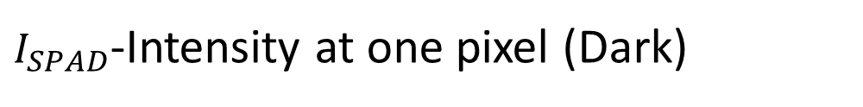
Added SPAD Noise
$$I_{SPAD}>\left\langle I_{SPAD}\right\rangle +3⋅σ_{ROI}⇒I_{SPAD}=NaN$$
Hot pixels threshold
$I_{SPAD}$-Intensity at one pixel (Dark)
$σ_{ROI}$-Standard deviation in pixel intensities in the image Region of Interest (ROI)

Slide 17
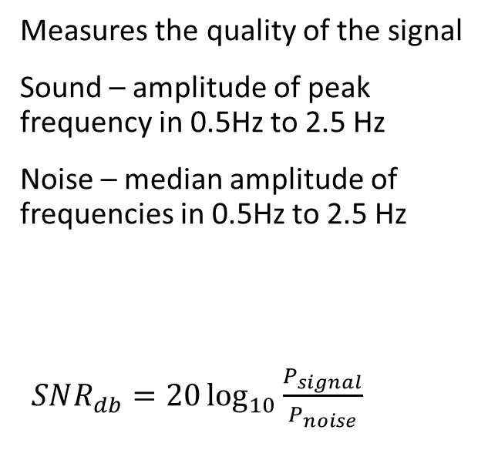
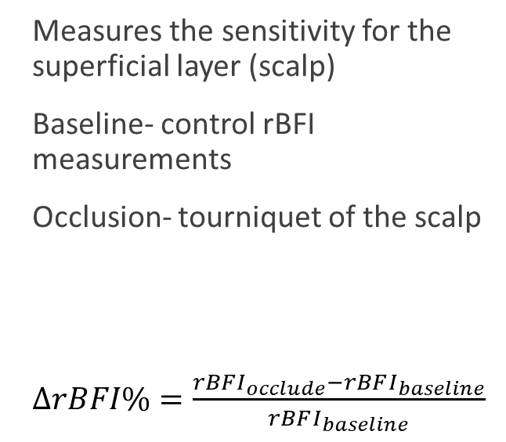
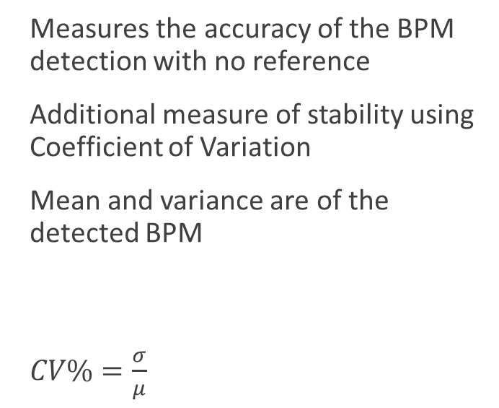
Metrics
Signal to Noise Ratio (SNR)
BPM Accuracy
Sensitivity
Measures the quality of the signal
Sound – amplitude of peak frequency in 0.5Hz to 2.5 Hz
Noise – median amplitude of frequencies in 0.5Hz to 2.5 Hz
$SNR_{db}=20\log_{10}{\frac{P_{signal}}{P_{noise}}}$
Measures the accuracy of the BPM detection with no reference
Additional measure of stability using Coefficient of Variation
Mean and variance are of the detected BPM
$CV\%=\frac{σ}{μ}$
Measures the sensitivity for the superficial layer (scalp)
Baseline- control rBFI measurements
Occlusion- tourniquet of the scalp
$ΔrBFI\%=\frac{rBFI_{occlude}−rBFI_{baseline}}{rBFI_{baseline}}$

Slide 18
PaLS-iSCOS vs Gated SCOS
SNR and BPM Experiments
Source Detector Separation (SDS) | Gated SCOS time gates | PaLS-iSCOS |  | Laser power Level
 |  | Time gate | Coherence gate
 |  |  |  | Gated SCOS | PaLS-iSCOS
1cm | -300ps to 1100ps | -300ps | -50ps to 900ps | 30%, 40% | 30%
1.5cm |  |  | -200ps to 750ps | 45%, 55% | 45%
2.5cm |  |  | -500ps to 400ps | 55% | 55%
Coherence gates limited by maximum reference arm length

Slide 19
PaLS-iSCOS vs Gated SCOS
Sensitivity Experiments
Source Detector Separation (SDS) | Gated SCOS time gates | iSCOS |  | PaLS-iSCOS |  | Laser power Level Gated SCOS PaLS-iSCOS
 |  | Time gate | Coherence gate | Time gate | Coherence gate
1cm | 0ps, 250ps, 500ps, 750ps | -300ps | 0ps, 250ps, 500ps | -200ps of the coherence gate | 0ps, 250ps, 500ps | 35%
1.5cm | 0ps, 250ps, 500ps |  |  |  |  | 45%
Fewer coherence gates due to time issues
3 stages (30s each):
Baseline
Tourniquet
Rest (only for 1.5cm)

Slide 20
PaLS-iSCOS vs Gated SCOS
Experiment Pipeline
Repeat for different pathlengths
TPSF measurement
Gated SCOS measurements
IRF measurement and adjustment
PaLS-iSCOS measurement
Measurements and calculations were handled through a custom camera GUI
Measure TPSF and extract the TPSF peak
Measure SCOS and subtract noise
Measure IRF and extract the IRF peak
Measure SCOS and subtract noise
Sweep around the TPSF peak for different gates
Calculate time difference between peaks

Slide 21
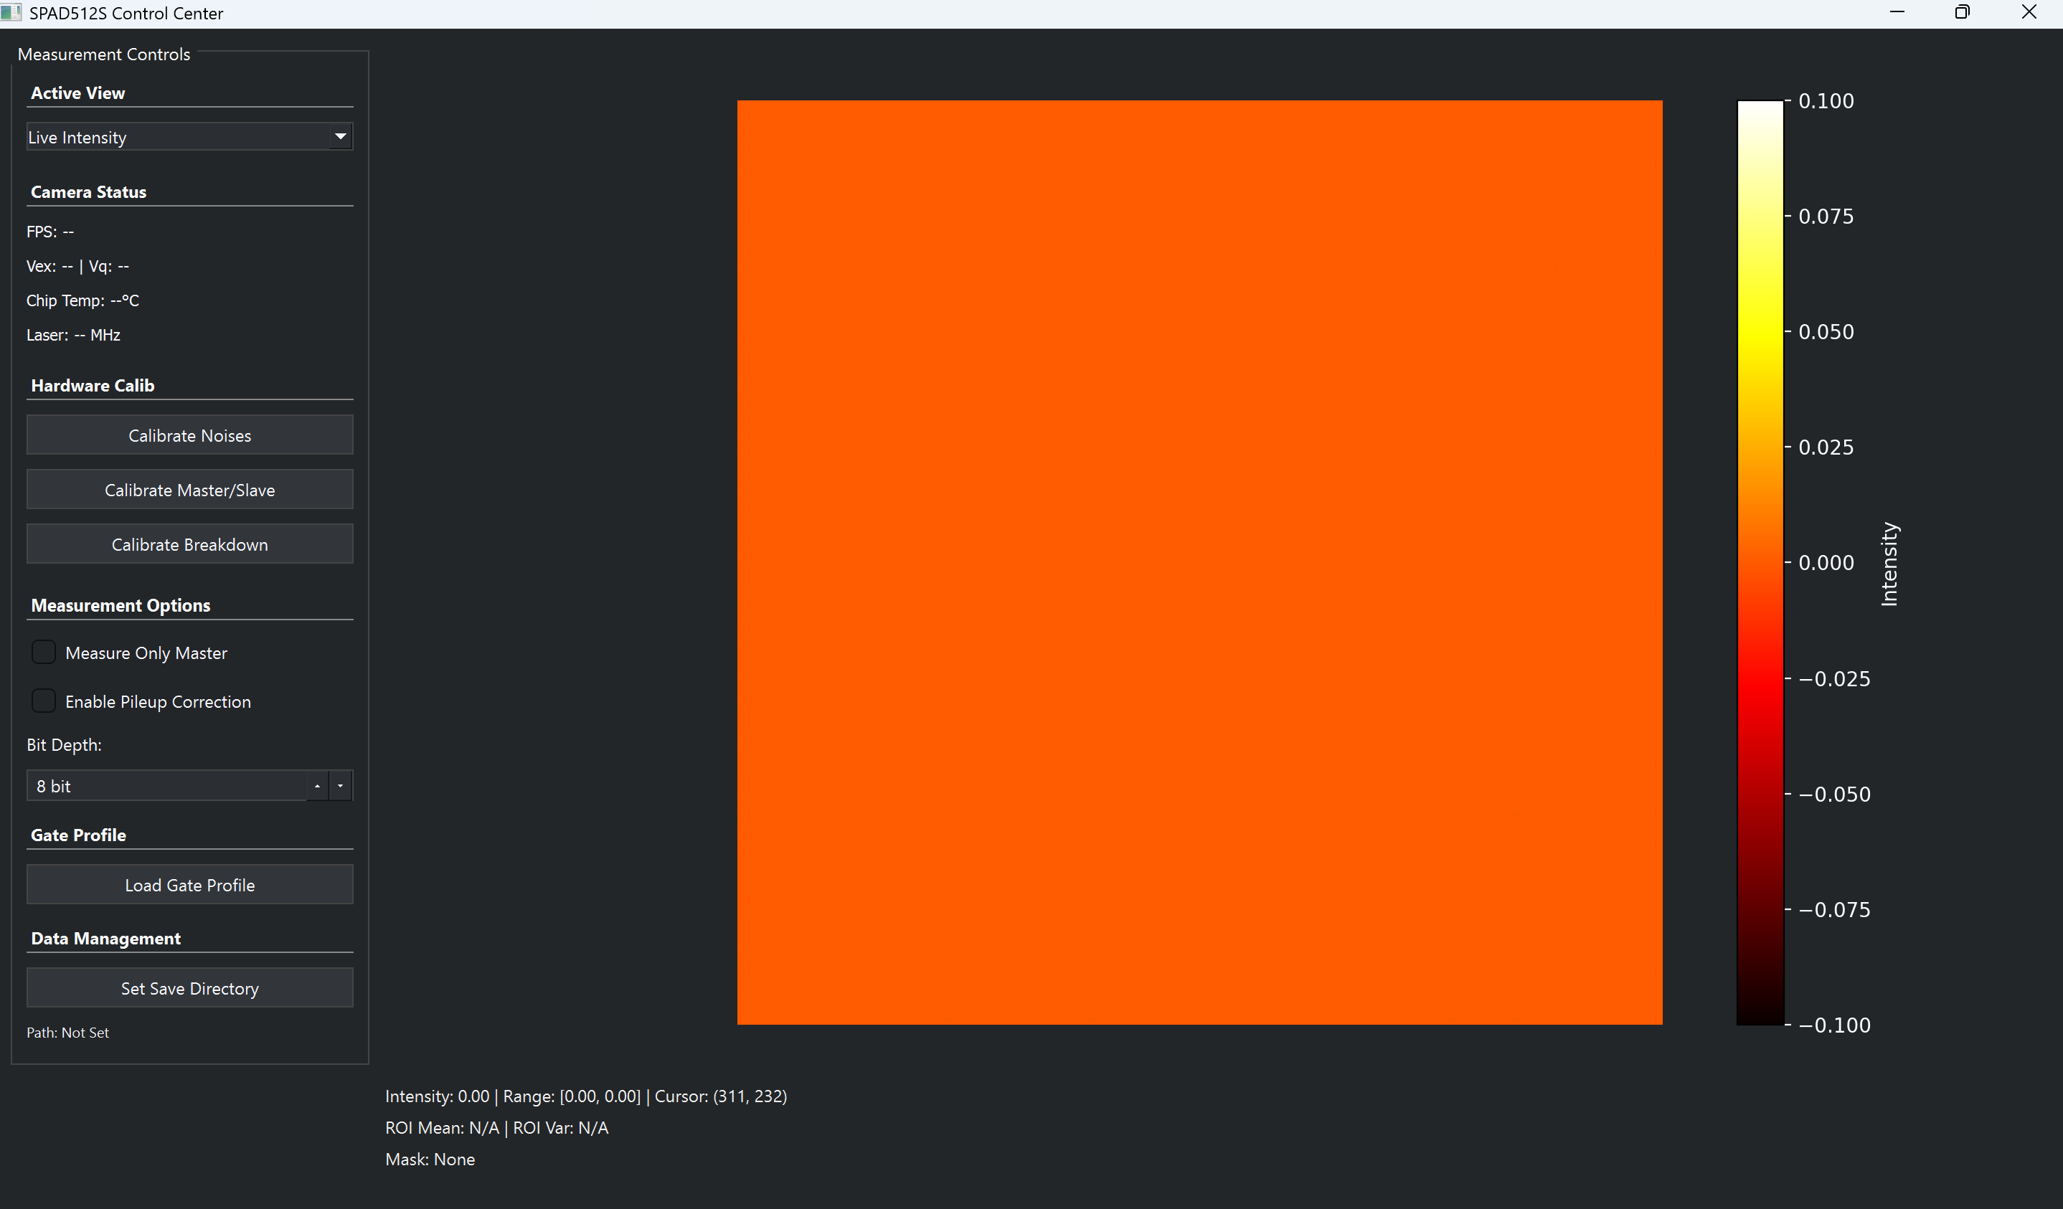
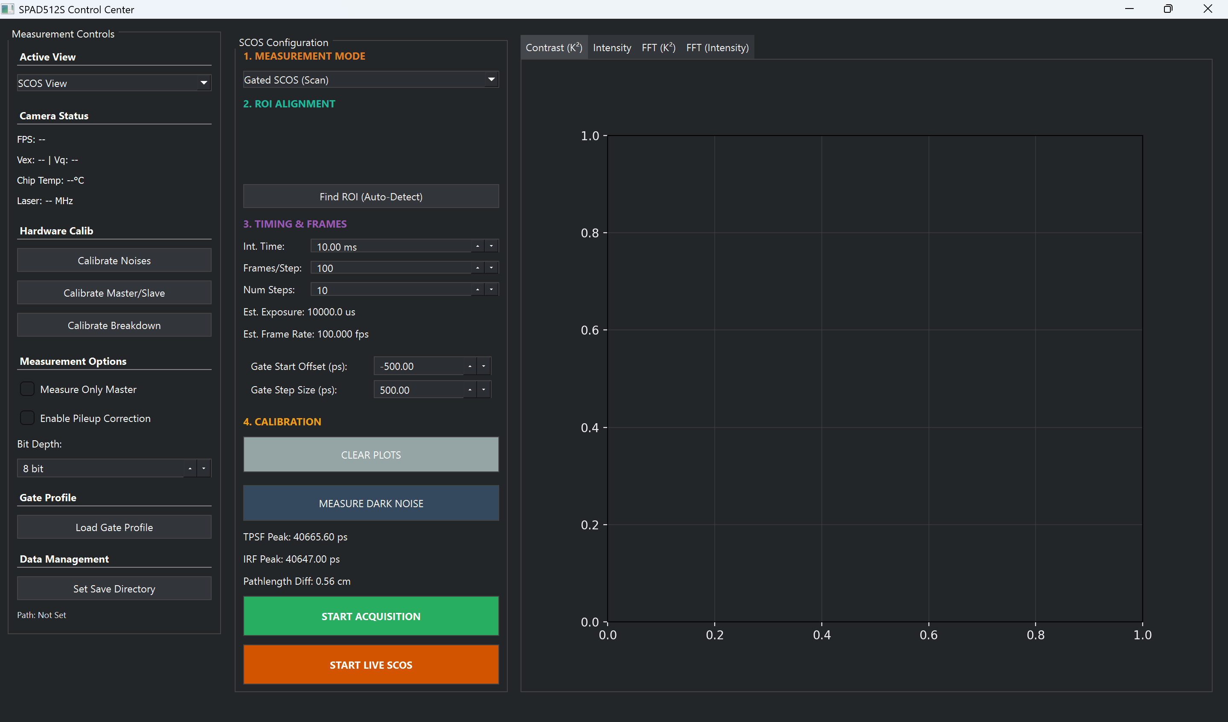
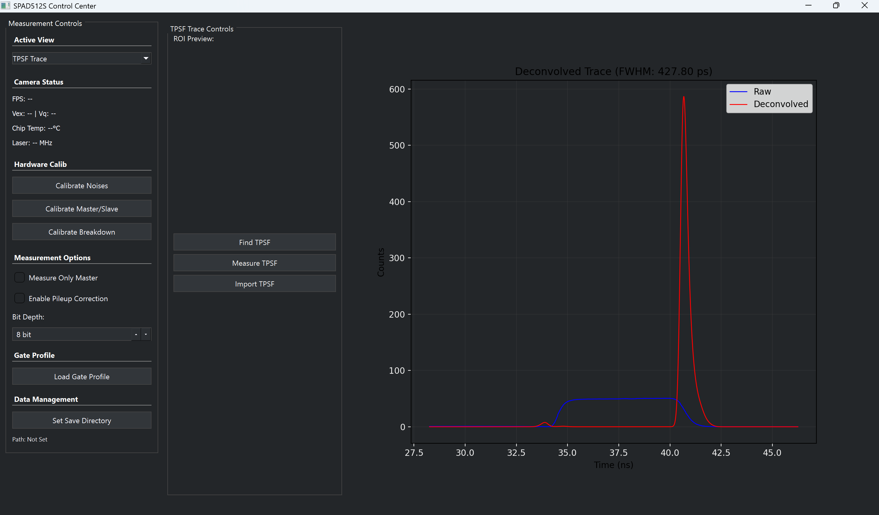
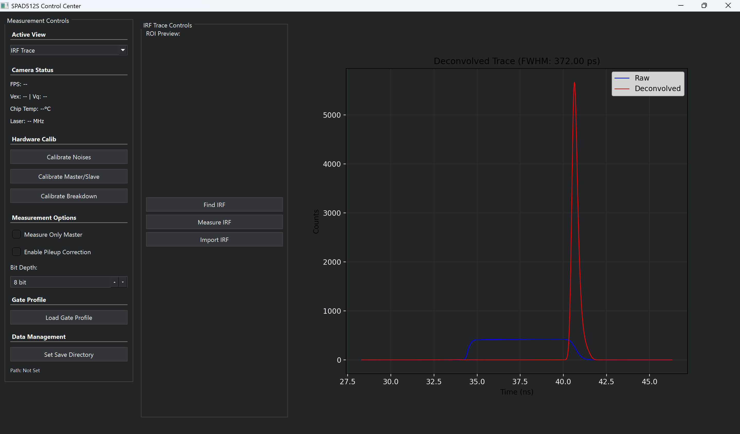
Live view
SCOS view
TPSF view
IRF view
GUI Build
Automatic communication with camera and image taking
Automatic noise and deconvolution calculation
TPSF\IRF, SCOS, and Live intensity windows

Slide 22
Results
TPSF and IRF Measurements
Gated-SCOS Measurements
PaLS-iSCOS Measurements
SNR
BPM
Sensitivity

Slide 23
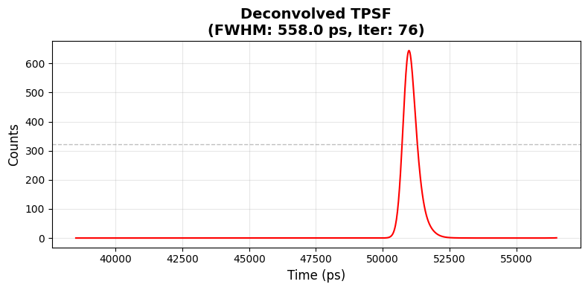
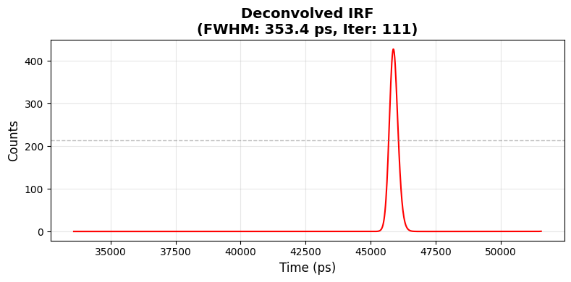
Results –TPSF and IRF
Both TPSF and IRF were measured successfully
FWHM of IRF matches the theoretical one (353.4ps vs ~350ps)
FWHMs make sense

Slide 24
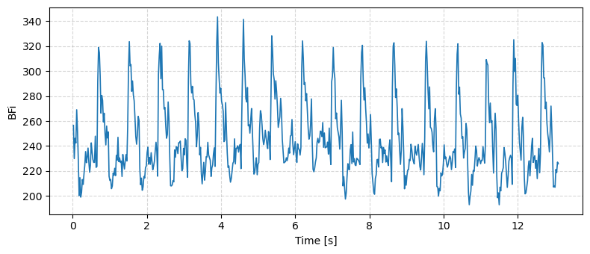
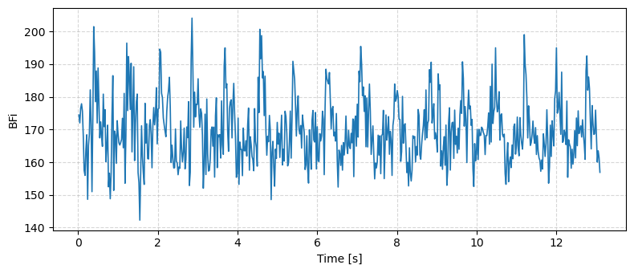
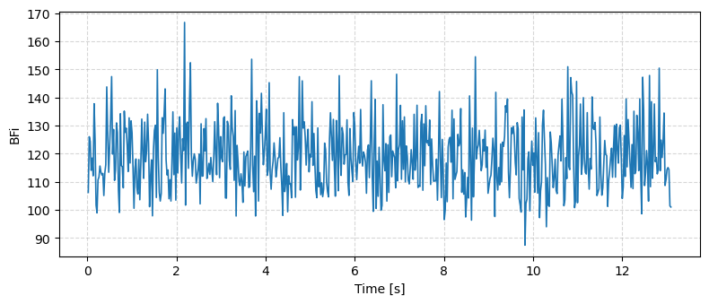
Results –Gated SCOS (1cm SDS)
Gate offset -100ps, BPM 73, SNR 18.59dB
Laser power:40%
Early gate has a good signal shape
Late gates are much noisier
SNR matches accordingly
Gate offset 200ps, BPM 73, SNR 20.83dB
Gate offset 700ps, BPM 92, SNR 7.92dB

Slide 25
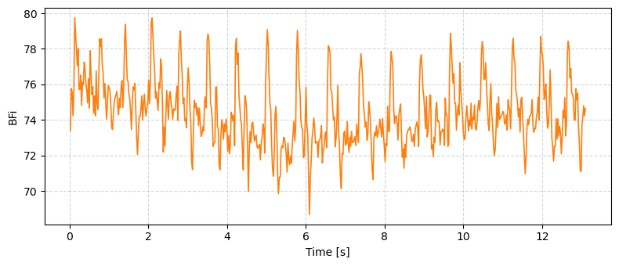
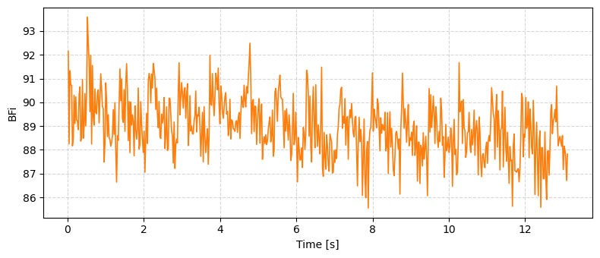
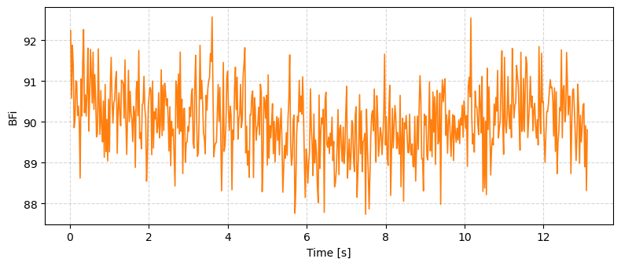
Results –PaLS-iSCOS (1cm SDS)
Gate offset -74ps, BPM 78, SNR 25.75dB
Laser power:30%
All with time gates of -300ps, different coherence gates
Early gates show the best SNR, as expected
Late gates show potential as well
Gate offset 242ps, BPM 73, SNR 20.90dB
Gate offset 763ps, BPM 82, SNR 9.35dB

Slide 26
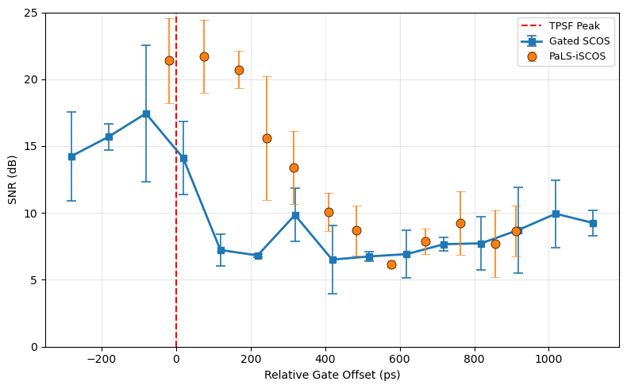
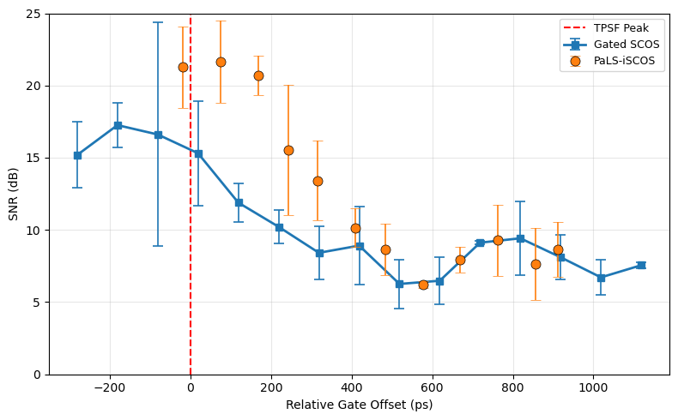
Early Results –SNR (1cm SDS)
Raw Contrast
Laser Power Level: 30%
Subtracting Noise shows limited improvement
PaLS-iSCOS has improved SNR
Corrected Contrast

Slide 27
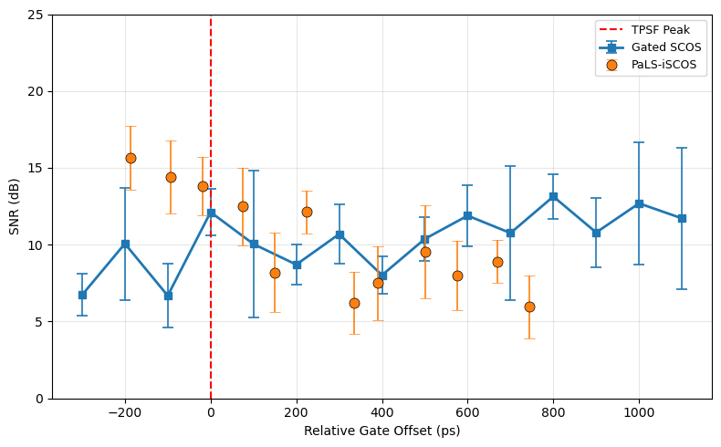
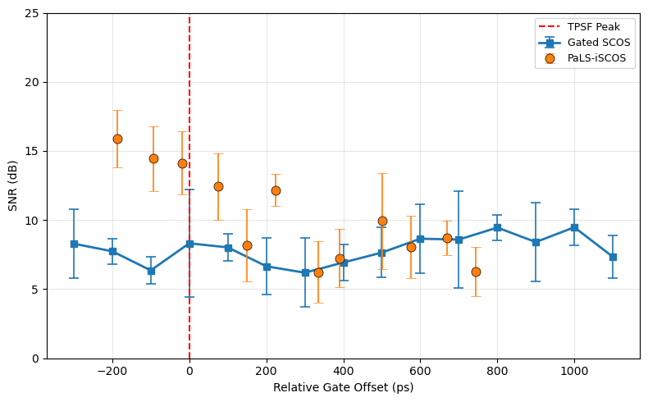
Early Results –SNR (1.5cm SDS)
Raw Contrast
Laser Power Level: 45%
Noise subtraction does not improve signal
PaLS-iSCOS has improved SNR, but for less gates
Corrected Contrast

Slide 28
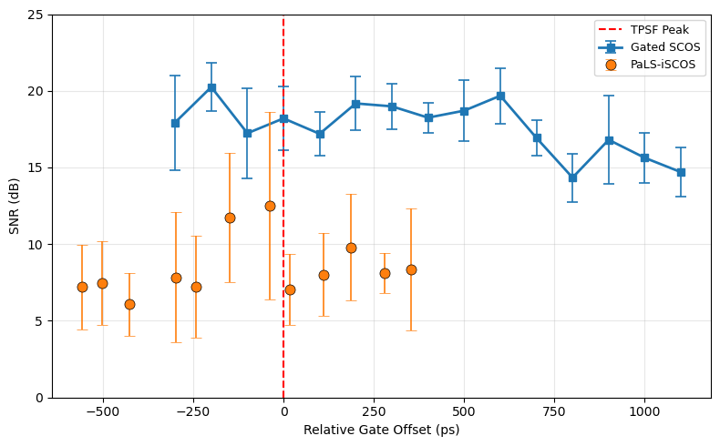

Early Results –SNR (2.5cm SDS)
Raw Contrast
Laser Power Level: 55%
Noise subtraction degrades signal
PaLS-iSCOS has lower SNR
Corrected Contrast

Slide 29



Results –BPM Accuracy
1cm SDS
1.5cm SDS
2.5cm SDS
Accuracy- between 60 to 100 BPM

Slide 30



Results –BPM CV
1cm SDS
1.5cm SDS
2.5cm SDS
CV- stability

Slide 31
Selected SDS for Sensitivity
SNR
Gate offset 242ps, BPM 73, SNR 20.90dB
1cm SDS:
  Better or similar SNR
  Better or similar signal quality
  Improved to similar accuracy
  Similar stability
1.5cm SDS was measured as well
Accuracy
Stability

Slide 32


Sensitivity Test Example(1cm)
Normalized rBFI vs Time (-25ps Coherence Gate)
Laser power:35%
PaLS-iSCOS examples from early and late gate
rBFI normalized based on the base window
The rBFI drop is lower for the late gate
The signal quality is better in occlusion
Normalized rBFI vs Time (500ps Coherence Gate)

Slide 33

Sensitivity Test(1cm)
Laser power:35%
PaLS-iSCOS shows the best sensitivity
Gated SCOS results after 300ps are unreliable

Slide 34

Sensitivity Test(1.5cm)
Laser power:45%
Noisy results all around

Slide 35
Discussions
TPSF and IRF Performance
SNR and BPM Performance
Sensitivity Metric Limitations
Signal Quality

Slide 36
Discussion –TPSF and IRF
While:
  FWHM of IRF matches the theoretical one
  FWHMs make sense
More validations are needed

Slide 37
Discussion –SNR and BPM Performance
SNR predicts BPM accuracy up to a noise floor (~10dB)
Measurements with ground truth BPM could improve accuracy validations
1cm SDS

Slide 38
Discussion – Signal Quality
Time gate offset 700ps, BPM 92, SNR 7.92dB
For late gate, poor signal quality
Achieving >10dB late gate could be done by:
  Increasing photon count
  Testing different sample-to-reference ratios
  Using a better camera sensor
Overall, the signal does show the physiological process of bloodflow
Coherence gate offset 763ps, BPM 82, SNR 9.35dB

Slide 39


Discussion –Sensitivity Metric Limitations
Sensitivity metric is very unreliable
Possible cause:
  Tourniquet fastens/changes probe position
  Intensity spikes
  At low photon count, it affects contrast
Rethinking the sensitivity test or metric is needed
Low Photon Count
High Photon Count

Slide 40
Conclusions
What is next
SCOS relies on speckle contrast to extract rBFi
The method can have good resolution, but lacks sensitivity and accuracy
Adding coherence and time gating could improve both sensitivity and SNR
Results show both improvement of sensitivity and SNR when selecting the right configuration
Validate TPSF and IRF profiles
Improve signal quality
Improve sensitivity test
Experiment with different sensors and setups

Slide 41
Thank you for listening!
Any Questions?

Slide 42
References
Zhu, J., He, X., & Chen, Z. (2018). Perspective: Current challenges and solutions of Doppler optical coherence tomography and angiography for neuroimaging. APL Photonics, 3(12), 120902. https://doi.org/10.1063/1.5040590
Thompson Rivers University. (n.d.). Research methods in psycholinguistics. Psychology of Language Pressbooks. https://psychologyoflanguage.pressbooks.tru.ca/chapter/research-methods-in-psycholinguistics/
Stanford Medicine. (n.d.). About NIRS. Center for Interdisciplinary Brain Sciences Research. https://med.stanford.edu/cibsr/GettingReady/about-nirs.html
Robinson, M. B., et al. (2025). Pathlength-selective, interferometric diffuse correlation spectroscopy. IEEE Journal of Selected Topics in Quantum Electronics, 31(4), 1–14. https://doi.org/10.1109/JSTQE.2025.3575719

Slide 43
Supplementary Slides

Slide 44

TPSF Measurement With Long Gate
$$m\left(t\right)=\left(h∗g_{rev}\right)\left(t\right)=\int_{0}^{W}{h\left(t−τ\right)g\left(W−τ\right)dτ}$$
Image captured by SPAD
True TPSF/IRF
SPAD gate (smearing effect)
Challenge: camera gate (6ns) is wider than IRF/TPSF FWHM (350ps to 700ps)
Solution: Richardson-Lucy Algorithm, an iterative solution to compute the TPSF
Stopping point: minimum MSE
$$h_{n+1}\left(t\right)=h_{n}\left(t\right)⋅\left[\frac{m\left(t\right)}{\left(h_{n}∗g_{rev}\right)\left(t\right)}\right]∗g(t)$$
$$MSE_{n}=\frac{1}{N}\sum_{i=1}^{N}{{\left(m_{i}\left(t_{i}\right)−\left(h_{n}∗g_{rev}\right)\left(t_{i}\right)\right)}^{2}}$$

Slide 45



TPSF Measurement With Long Gate
Challenge: camera gate (6ns) is wider than IRF/TPSF FWHM (350ps to 700ps)
Solution: Richardson-Lucy Algorithm, an iterative solution to compute the TPSF
Stopping point: minimum MSE

Slide 46

Theory behind PaLS-iDCS
As for the (final) autocorrelation function, we get:
$$g_{2}\left(t_{g},τ\right)=1$$
$$+\frac{β_{p}}{M{\left\langle I_{T}\left(t_{g}\right)\right\rangle }^{2}}({\left\langle I_{s}\right\rangle }^{2}\int_{0}^{∞}{\int_{0}^{∞}{P^{′}\left(s^{′},t_{g}\right)g_{1}\left(τ,s′\right)P^{′}\left(s,t_{g}\right)g_{1}\left(τ,s\right)e^{−\frac{2{\left(s−s^{′}\right)}^{2}}{l_{c}^{2}}}dsds^{′}}}$$
$$+ 2\left\langle I_{s}\right\rangle \left\langle I_{R}\right\rangle \int_{0}^{∞}{P^{′}\left(s,t_{g}\right)g_{1}\left(τ,s\right)IRF(t_{g}−{l_{R}}/v) e^{−\frac{2{\left(s−l_{R}\right)}^{2}}{l_{c}^{2}}}ds)}$$
where M is the number of detected spatial modes, $\left\langle I_{T}\left(t_{g}\right)\right\rangle$ is the average total intensity that falls within the selected time gate centered at $t_{g}$, $\left\langle I_{s}\right\rangle ,\left\langle I_{R}\right\rangle$ are the average sample and reference arm intensity respectively, $l_{R}$ is the length of the reference arm pathlength, and $β_{p}$ is the polarization-dependent coherence factor: $β_{p}=\frac{I_{∥}^{2}+I_{⊥}^{2}}{{\left(I_{∥}+I_{⊥}\right)}^{2}}$

Slide 47

Theory behind PaLS-iDCS
Let’s divide the function to two parts (excluding the 1 and $\frac{β_{p}}{M{\left\langle I_{T}\left(t_{g}\right)\right\rangle }^{2}}$ ):
1 - ${\left\langle I_{s}\right\rangle }^{2}\int_{0}^{∞}{\int_{0}^{∞}{P^{′}\left(s^{′},t_{g}\right)g_{1}\left(τ,s′\right)P^{′}\left(s,t_{g}\right)g_{1}\left(τ,s\right)e^{−\frac{2{\left(s−s^{′}\right)}^{2}}{l_{c}^{2}}}dsds^{′}}}$
2 - $2\left\langle I_{s}\right\rangle \left\langle I_{R}\right\rangle \int_{0}^{∞}{P^{′}\left(s,t_{g}\right)g_{1}\left(τ,s\right)IRF(t_{g}−{l_{R}}/v) e^{−\frac{2{\left(s−l_{R}\right)}^{2}}{l_{c}^{2}}}ds)}$
The first term can be identified as a traditional TD-DCS, While the second term is unique for PaLS-iDCS.
Now, let’s assume a high reference intensity is selected ($\left\langle I_{R}\right\rangle ≫\left\langle I_{s}\right\rangle )$

Slide 48

Theory behind PaLS-iDCS
We will drop the first term, giving us:
$$g_{2}\left(t_{g},τ\right)=1$$
$$+ 2\left\langle I_{s}\right\rangle \left\langle I_{R}\right\rangle \int_{0}^{∞}{P^{′}\left(s,t_{g}\right)g_{1}\left(τ,s\right)IRF(t_{g}−{l_{R}}/v) e^{−\frac{2{\left(s−l_{R}\right)}^{2}}{l_{c}^{2}}}ds)}$$
We still have $t_{g}$ dependency, but we can subvert that by a few principles that move the dependency to $l_{R}$.

Slide 49

Theory behind PaLS-iDCS
First, if we look at the coherence gate function, we can see that we achieve a peek at ${s=l}_{R}$:
$${\text{Γ}(s−l_{R})=e}^{−\frac{2{\left(s−l_{R}\right)}^{2}}{l_{c}^{2}}}$$
This function defines the interference window. interference is only significant when the optical pathlength s of the scattered sample photon matches the reference arm pathlength $l_{R}$​ within the coherence length $l_{C}$​ of the light source.
i.e., $l_{R}$ defines the coherence gate.

Slide 50

Theory behind PaLS-iDCS
Now, we must take into account $P^{′}\left(s,t_{g}\right)$ and $IRF(t_{g}−{l_{R}}/v)$.
While the equation includes dependencies on both the effective pathlength distribution $P^{′}\left(s,t_{g}\right)$and the instrument response function $IRF\left(t_{g}−{l_{R}}/v\right)$, in PaLS-iDCS these are not independently varied or scanned.
Instead, due to the interference mechanism, the reference arm length $l_{R}$​ effectively sets the gate center $t_{g}$​, because photons with pathlength ${s=l}_{R}$​ will arrive at:
$$t_{g}≅{l_{R}}/v$$

Slide 51

Theory behind PaLS-iDCS
This means that $t_{g}$​ is chosen based on $l_{R}$​to select photons of specific pathlengths.
This is the connection between time and coherence gate!
Now, let’s discuss how to extract the optical properties of the system.

Slide 52

Theory behind PaLS-iDCS
Since we are still using the Siegert relation, the general form is still:
$$g_{2}(t_{g},τ)=1+β(t_{g}){\left|g_{1}\left(t_{g},τ\right)\right|}^{2}$$
So, to infer $β(t_{g})$, we can use $τ=0$ and multiple $t_{g}$ to get $β\left(t_{g}\right)$ at different time points:
$$β\left(t_{g}\right)=$$
$$\frac{β_{p}}{M{\left\langle I_{T}\left(t_{g}\right)\right\rangle }^{2}}({\left\langle I_{s}\right\rangle }^{2}\int_{0}^{∞}{\int_{0}^{∞}{P^{′}\left(s^{′},t_{g}\right)P^{′}\left(s,t_{g}\right)e^{−\frac{2{\left(s−s^{′}\right)}^{2}}{l_{c}^{2}}}dsds^{′}}}$$
$$+ 2\left\langle I_{s}\right\rangle \left\langle I_{R}\right\rangle \int_{0}^{∞}{P^{′}\left(s,t_{g}\right)IRF(t_{g}−{l_{R}}/v) e^{−\frac{2{\left(s−l_{R}\right)}^{2}}{l_{c}^{2}}}ds)}$$
From here, we can fit $β\left(t_{g}\right)$ and estimate the optical properties.

Slide 53
Supp References
Wang, Q.; Bi, R.; Zheng, S.; Erdogan, A.T.; Qi, Y.; Li, C.; Hua, Y.; Pan, M.; Wang, Y.; Finlayson, N.; et al. Fiber-Based Ultra-High-Speed Diffuse Speckle Contrast Analysis System for Deep Blood Flow Sensing Using a Large SPAD Camera. Biosensors 2025, 15, 514. https://doi.org/10.3390/bios15080514

